Slide 1
STIRLING AUTISM RESEARCH (STAR) Room
LANDMARKS AND ROOM PHOTOS

Slide 2
PICTURES OF THE STAR ROOM

Slide 3
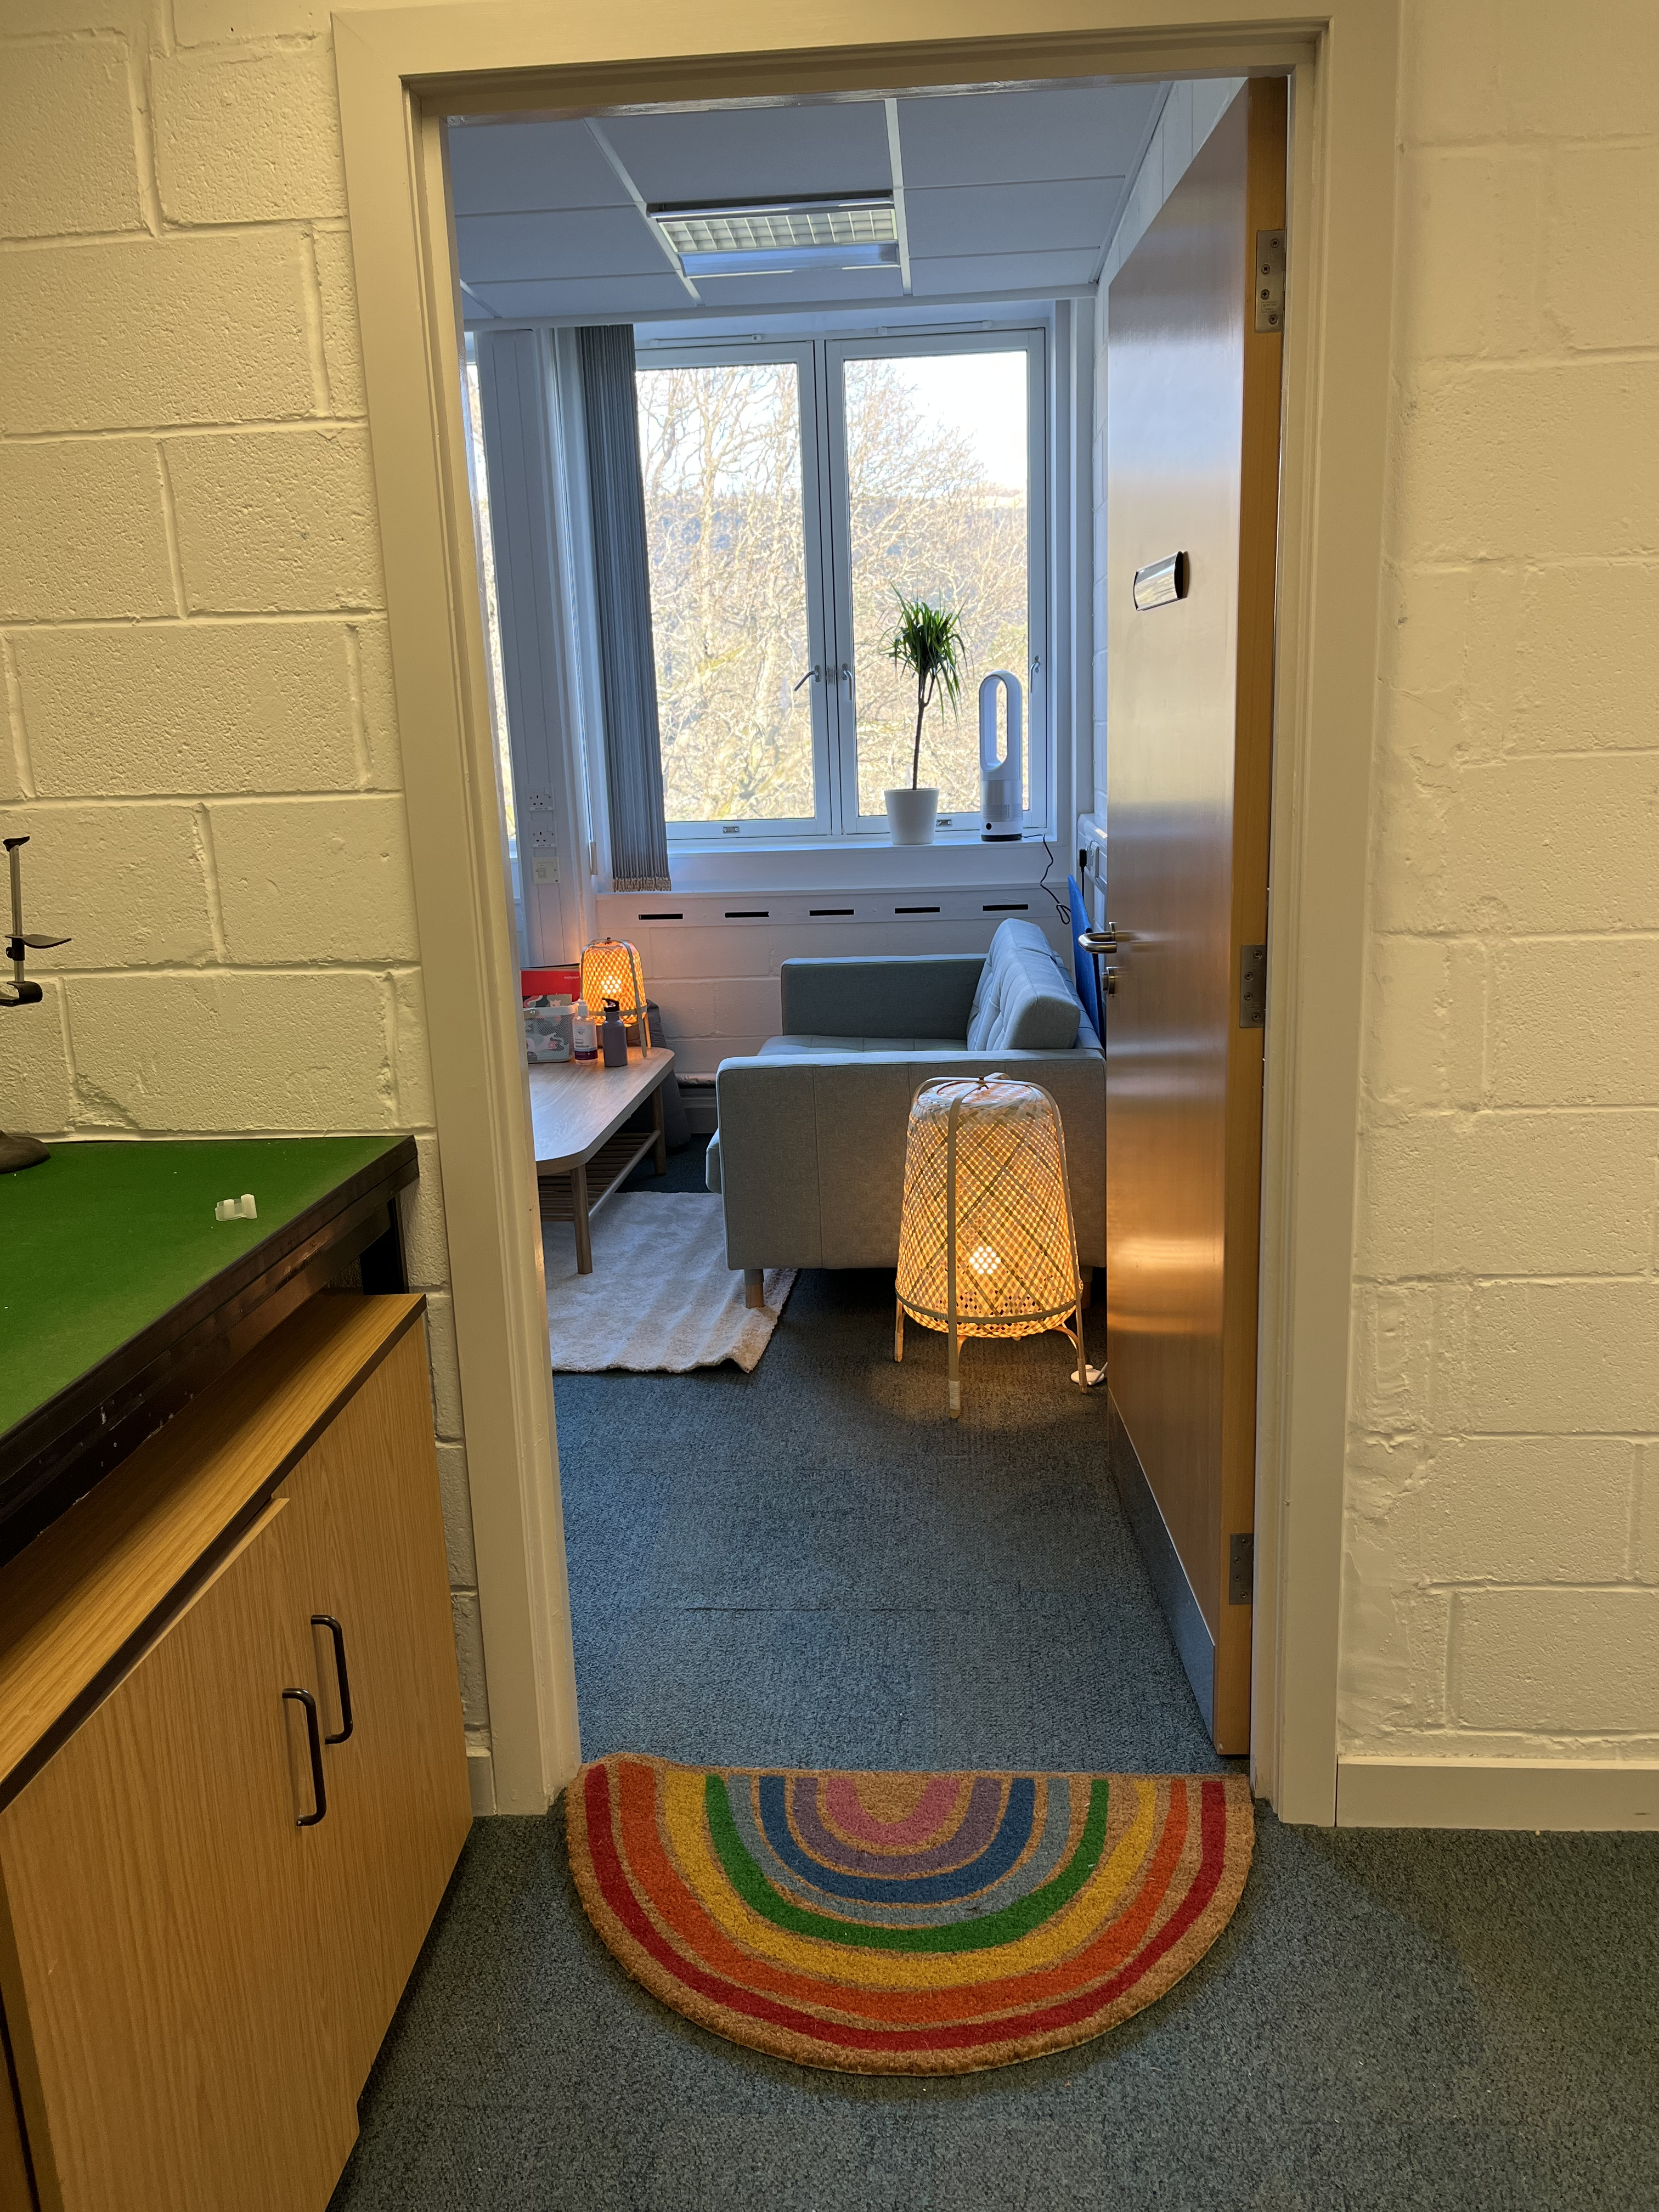
A picture of the door entrance to the STAR Room, with a rainbow entrance mat and sofa in the background.

Slide 4
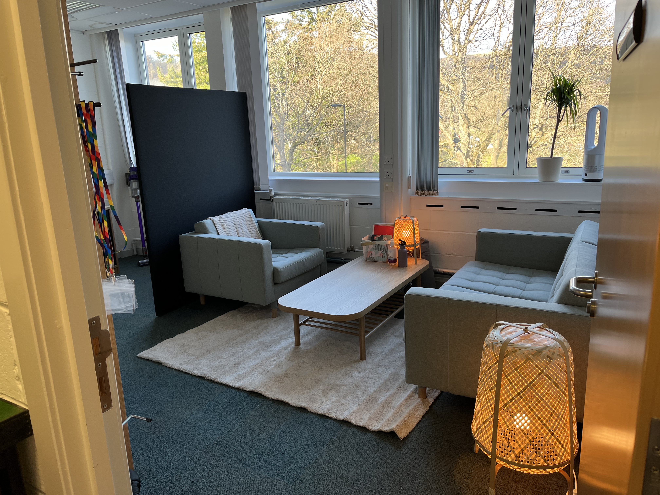
A picture of the seating area in the STAR Room. This shows two comfy seats, two lights and a coffee table.
To the left you can see a black room divider.

Slide 5
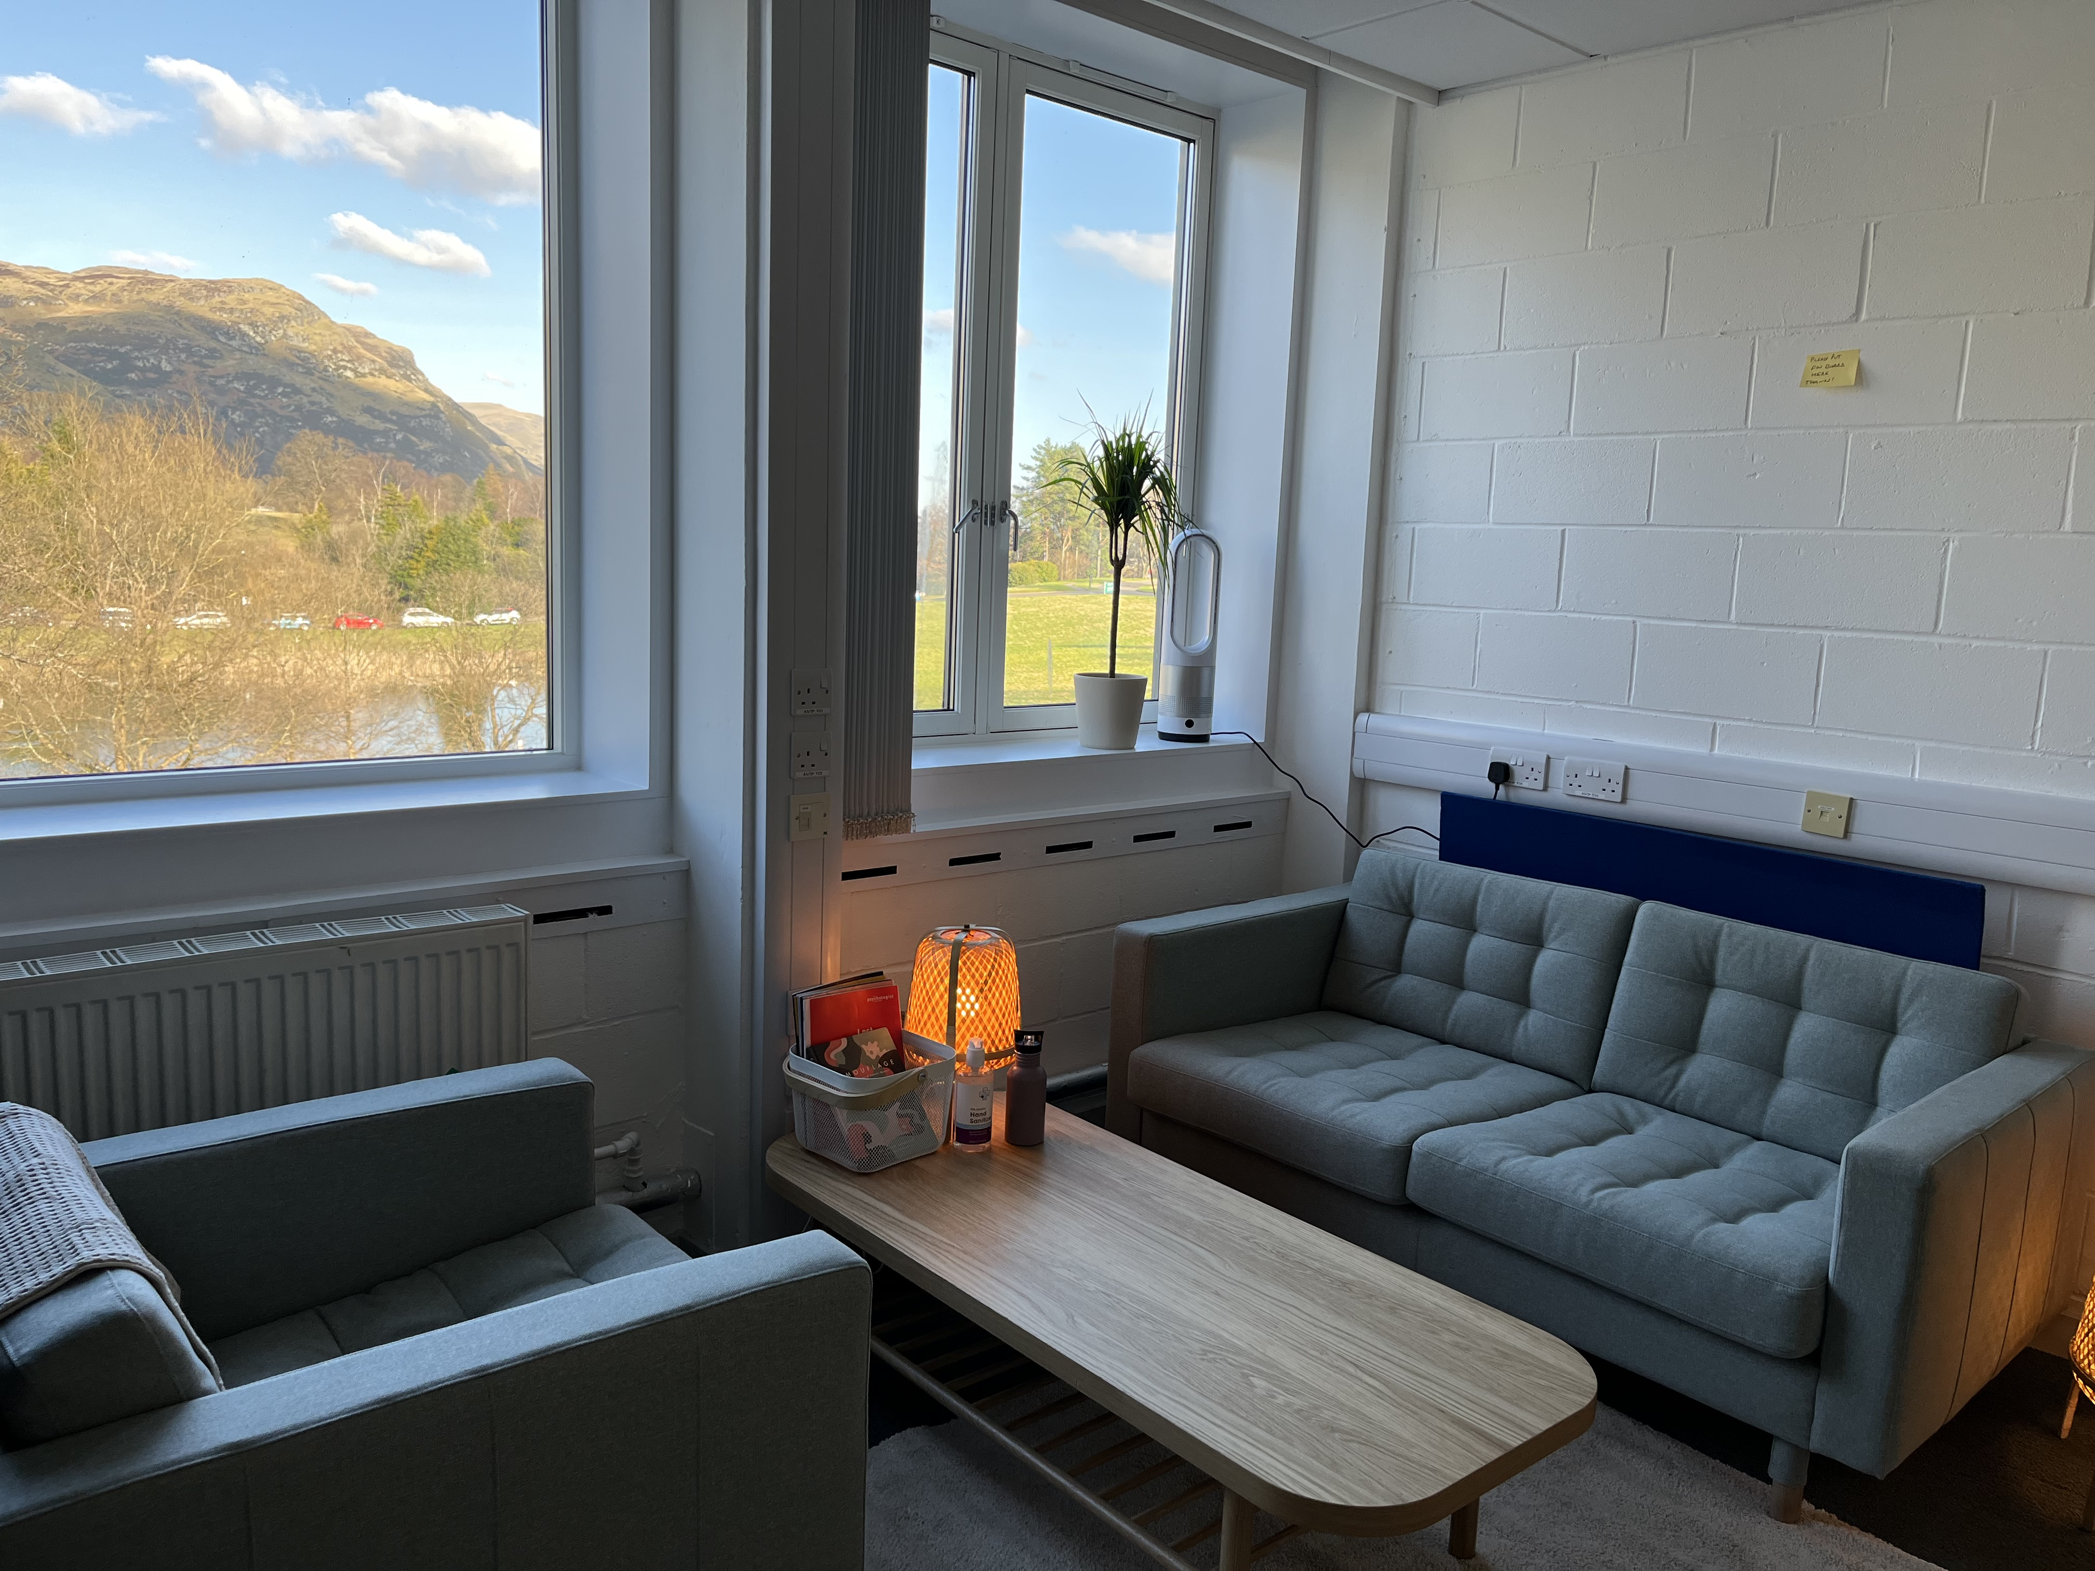
A second picture of the STAR Room seating area. Here you can see the view from the lab of the hills.

Slide 6
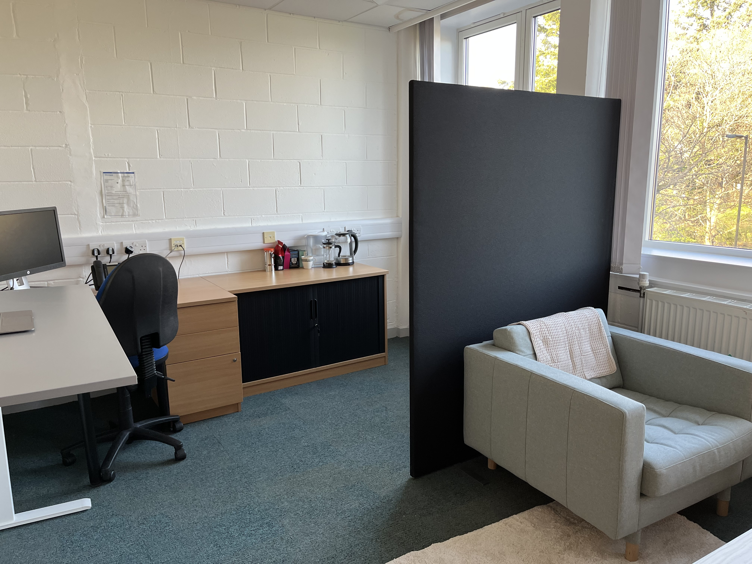
A picture of the office area of the STAR Room. To the left you can see a desk and desktop computer. In the middle you can see a kettle and boxes of tea and coffee.

Slide 7
LIST OF Room RESOURCES
Lamps for adjustable lighting
Sensory Box
Fidget toys
Quiet Fan
Height-adjustable desk (wheelchair accessible)
Weighted blanket
Window Blinds
Ear Defenders
Teas, Coffee and Biscuits for all visitors…..

Slide 8
LANDMARKS
Below you can find pictures of key landmarks on the route between the University Bus Hub and the STAR Room.
If you are having trouble finding the Cottrell Building on campus, or finding the meet-up location, please call or text our lab mobile on 07798 52014, or send an email to autismresearch@stir.ac.uk

Slide 9
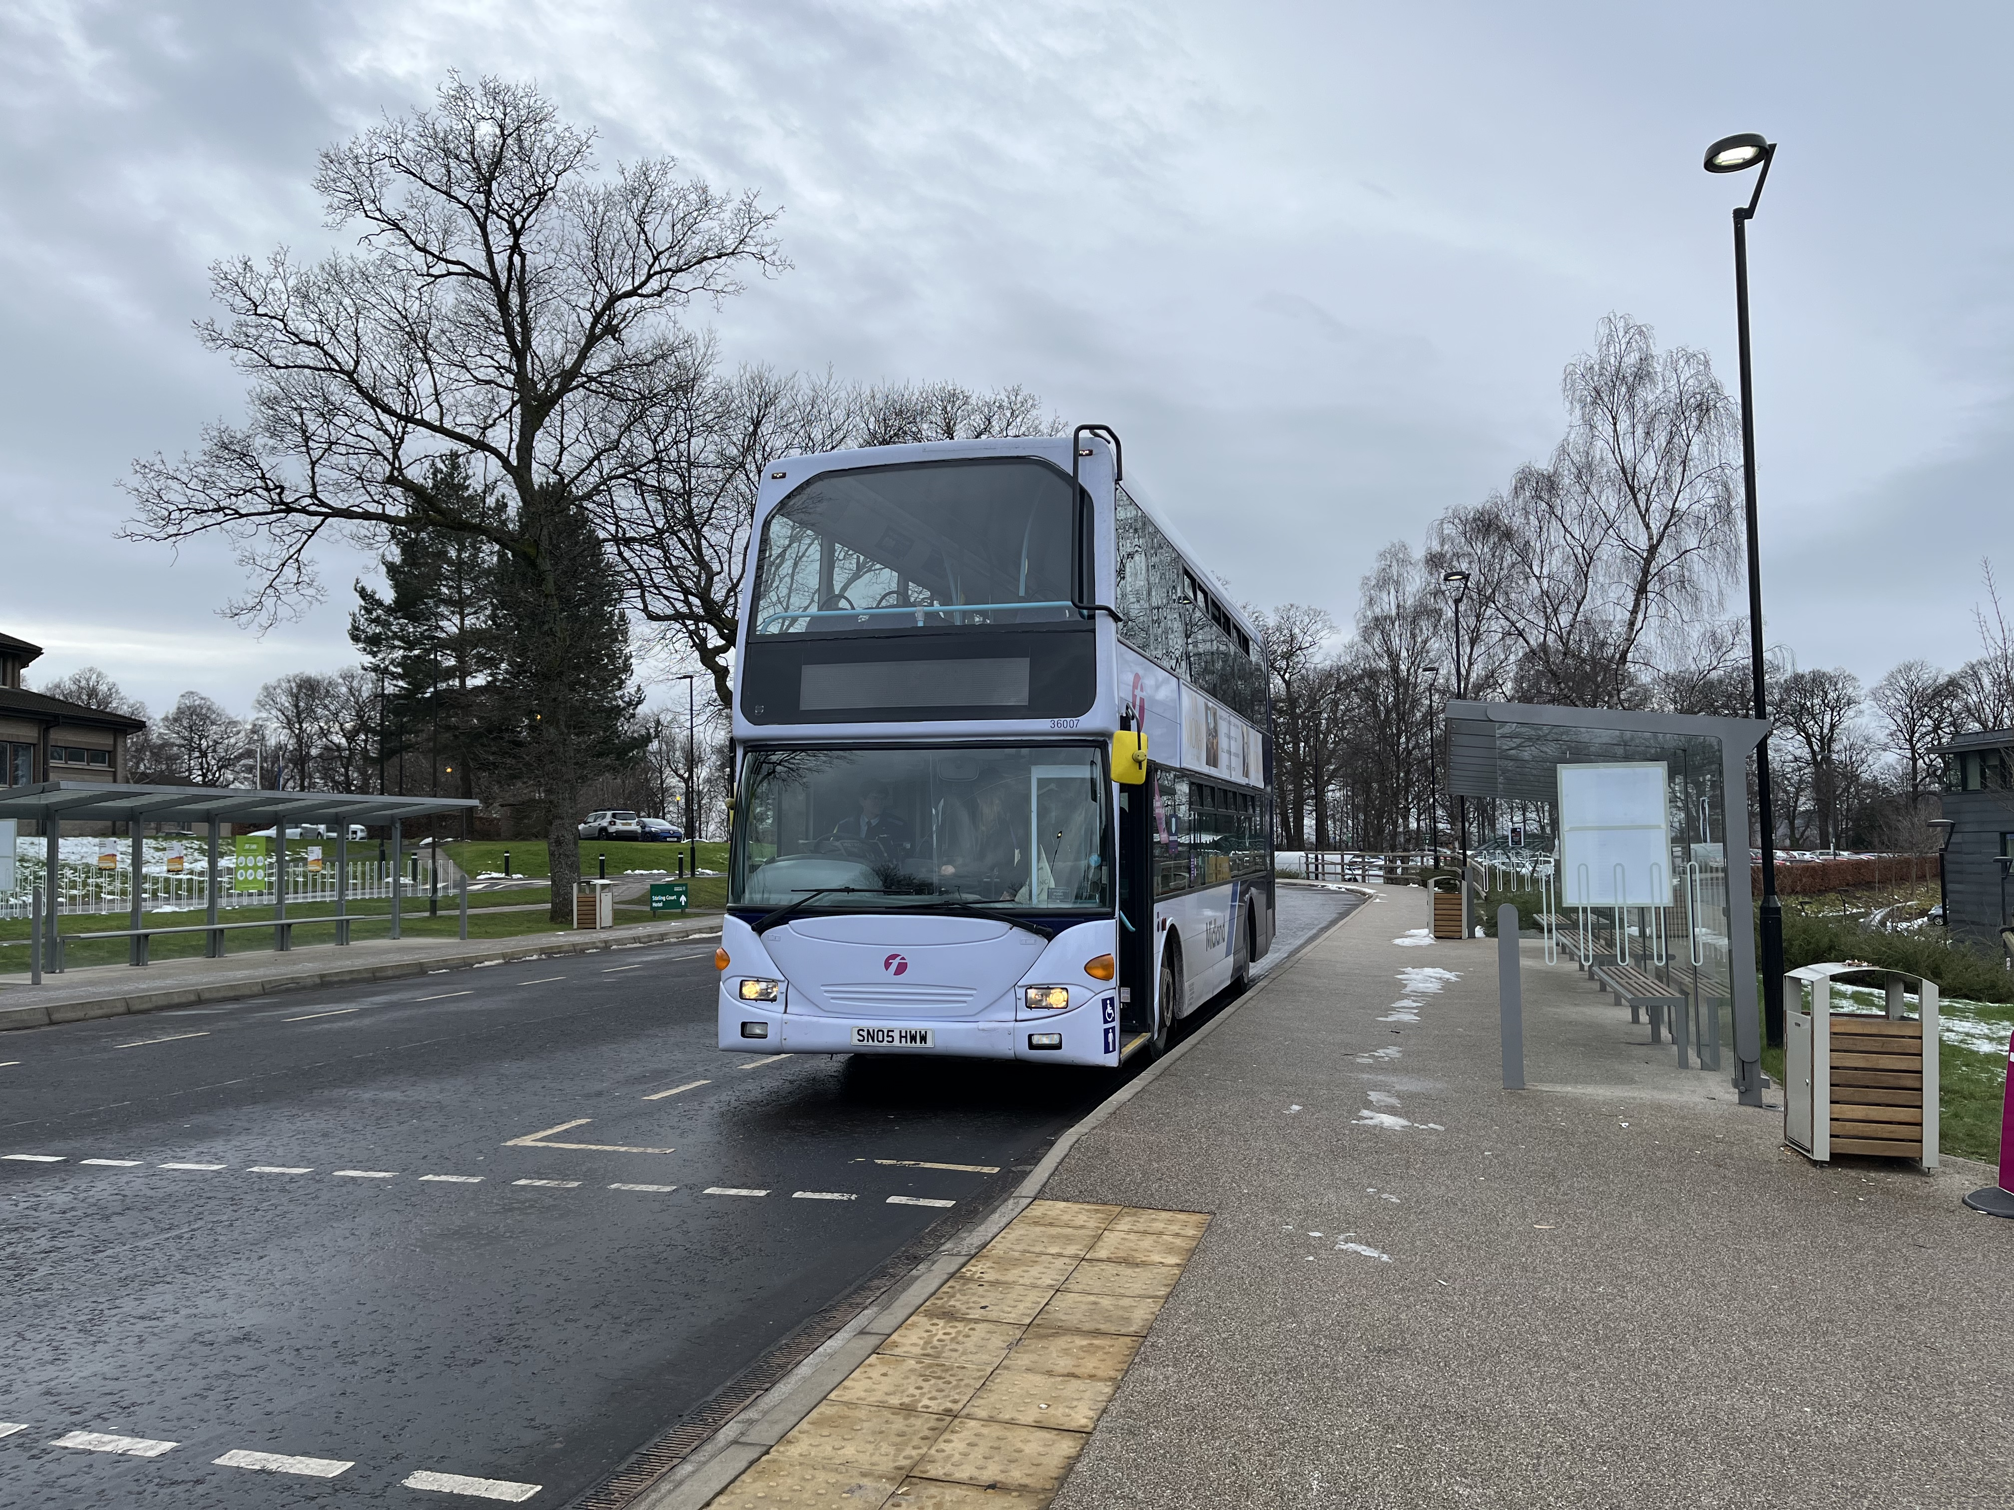
A picture of the University Bus Hub, showing a parked bus and an empty bus stop.

Slide 10
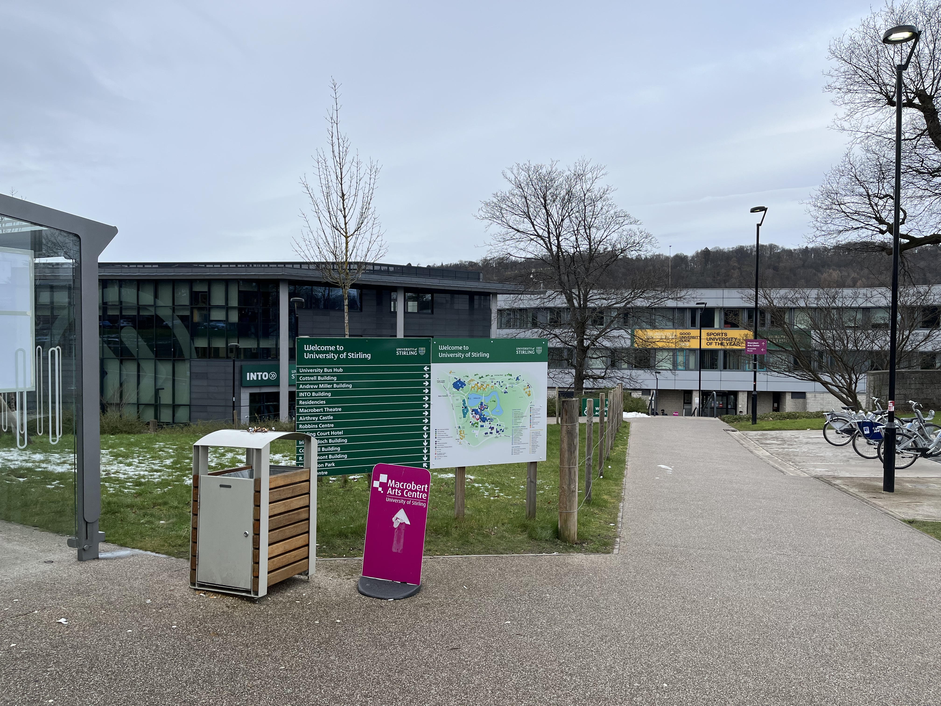
A picture of the Cottrell building on campus, as seen from the University Bus Hub. The entrance to the building is just under the two yellow signs.

Slide 11
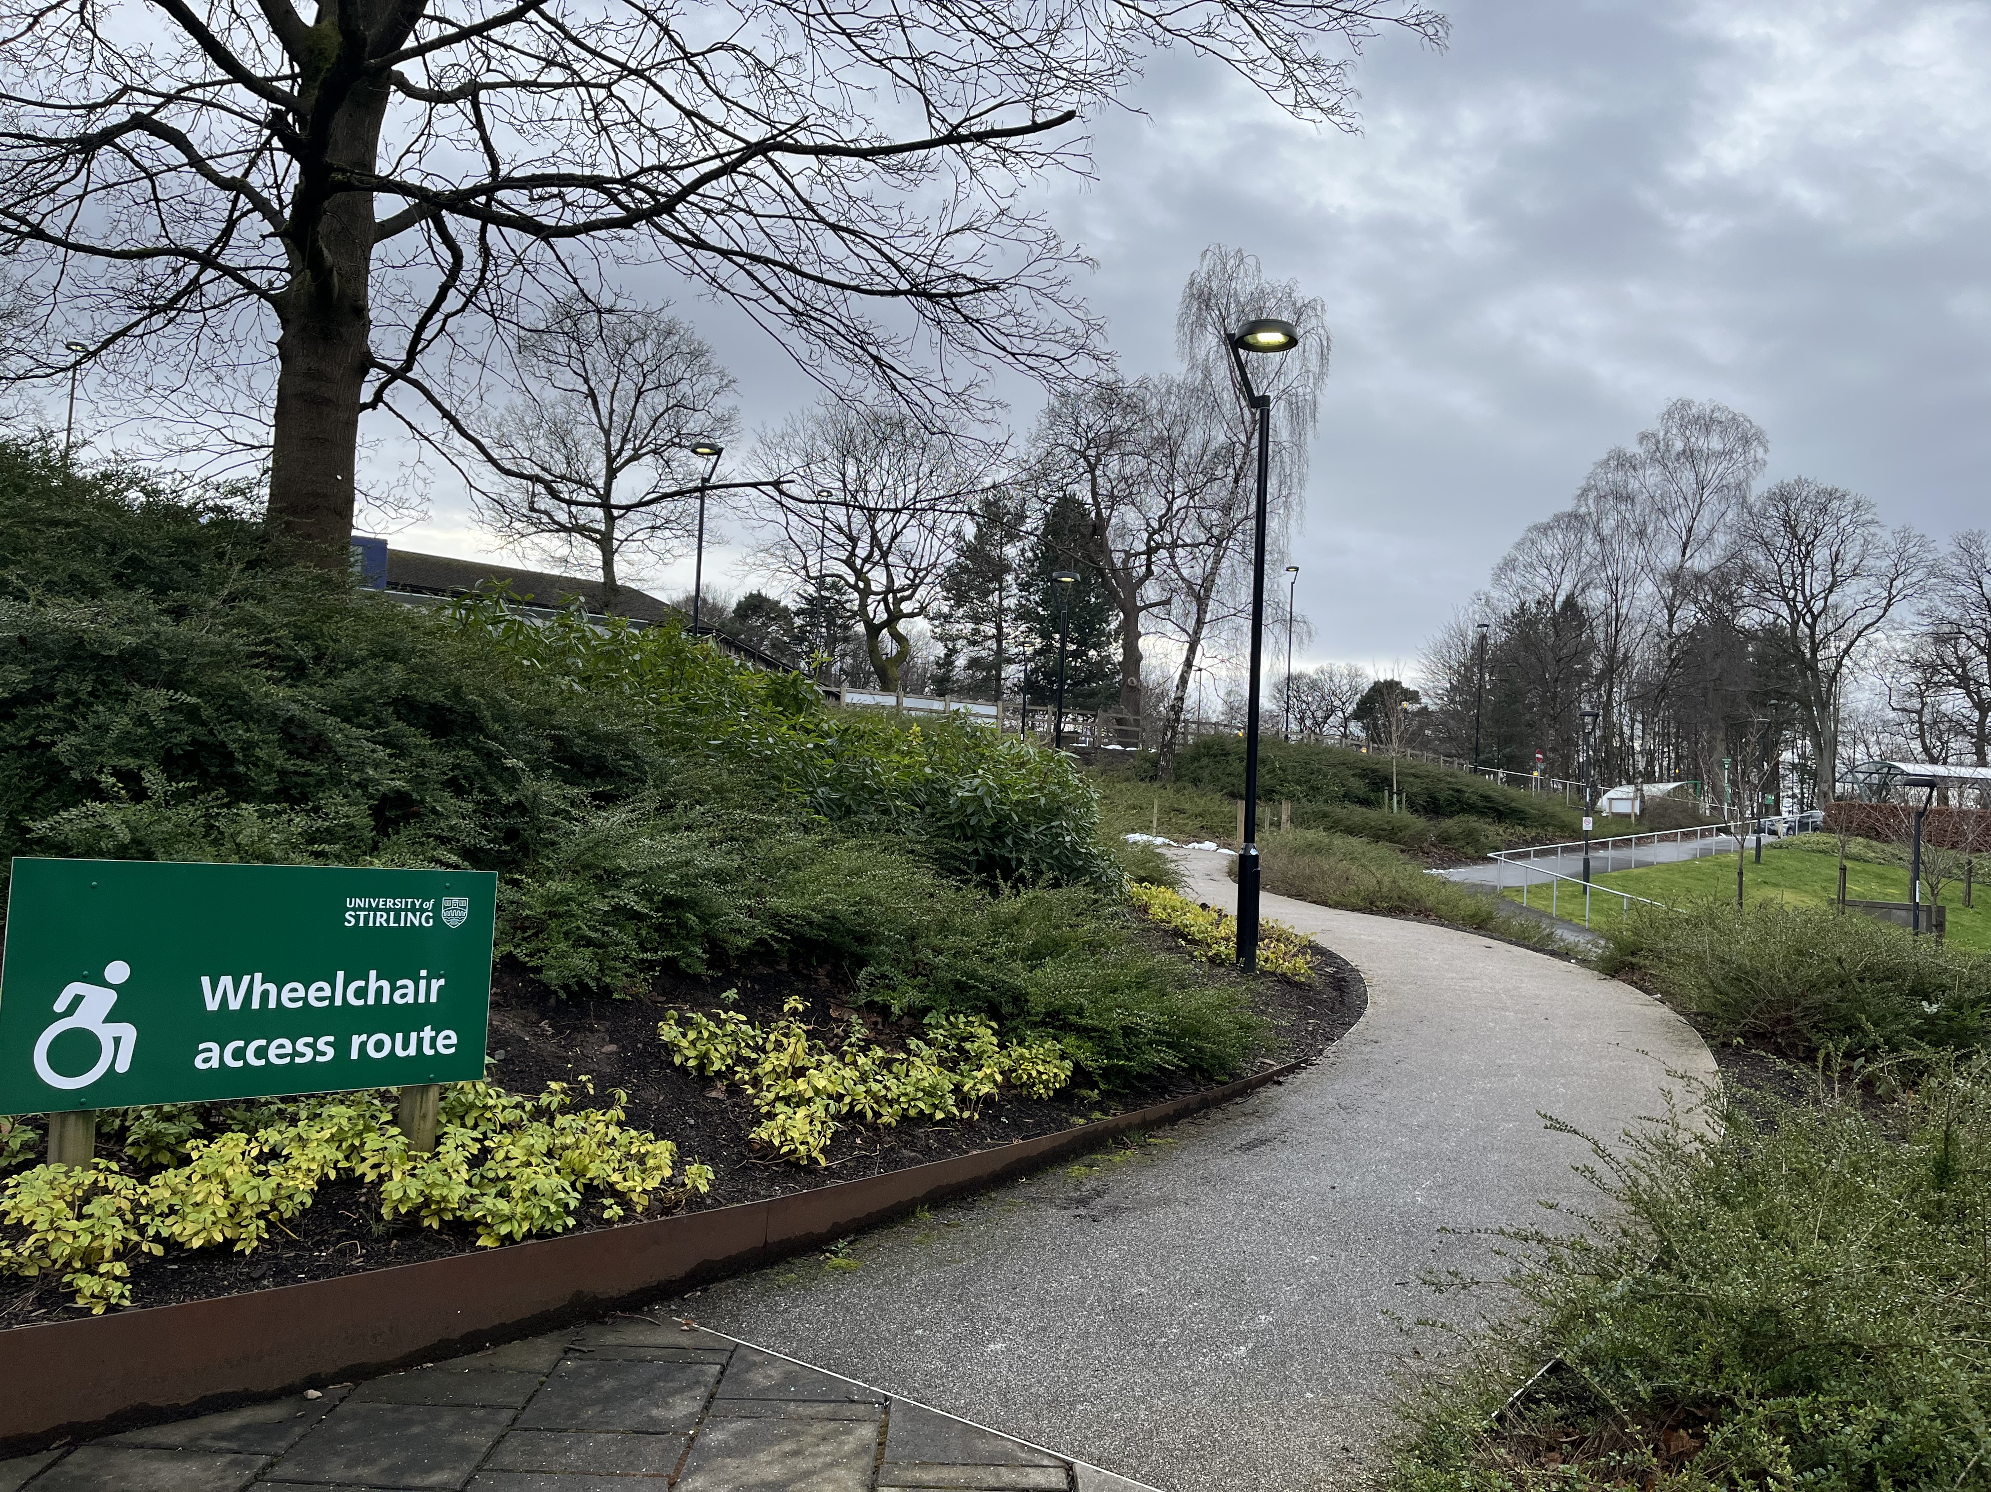
A picture of the wheelchair access route between the University Bus Hub and the entrance to the Cottrell Building.

Slide 12
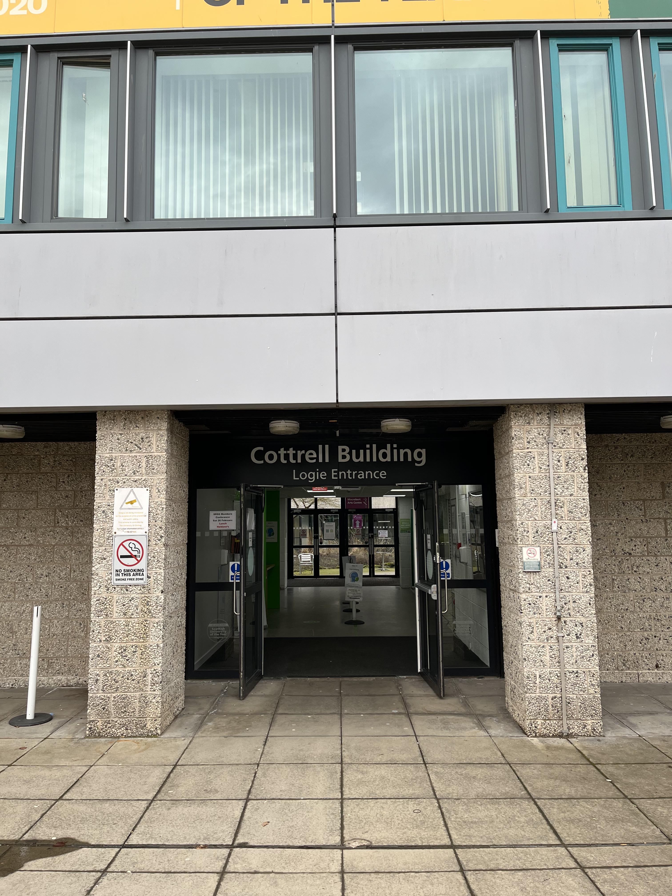
A picture of the entrance to the Cottrell building, when coming from the Bus Stop and Car park. This is called the Logie Entrance.

Slide 13
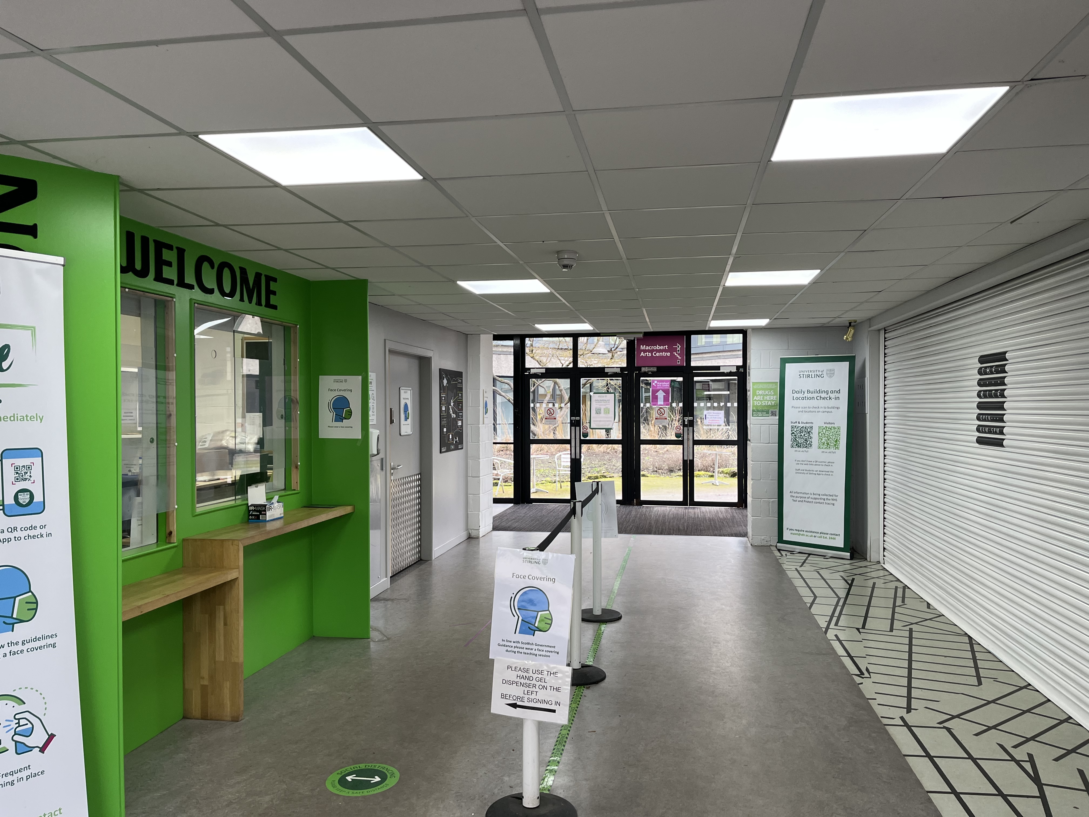
A picture of the reception area, just through the Logie Entrance to the Cottrell Building.

Slide 14
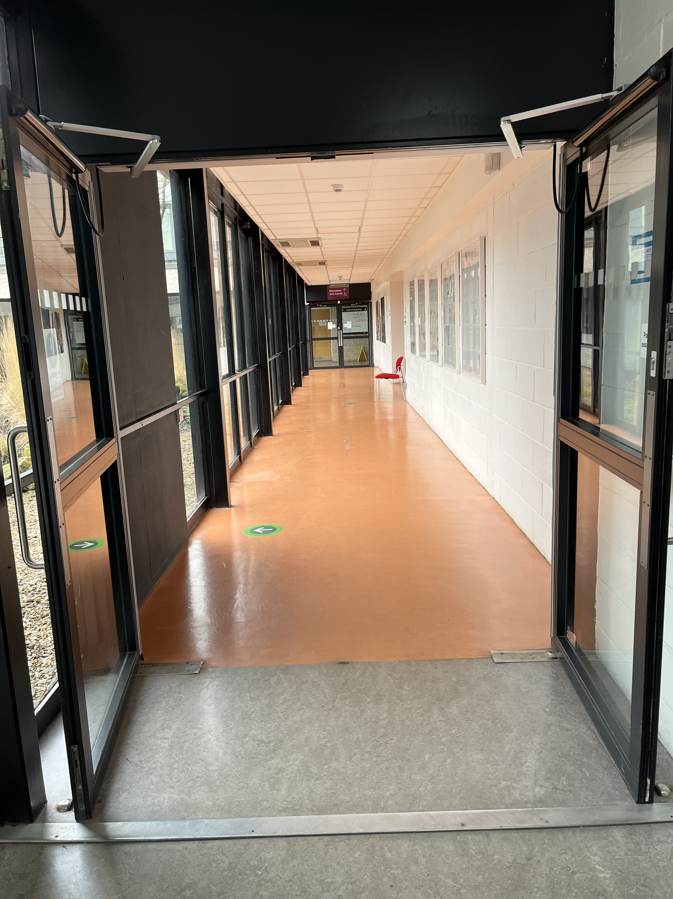
A picture of Corridor 2W which leads from the Logie Entrance to the corridor the STAR Room is on.

Slide 15
LANDMARKS
Below you can find pictures of key landmarks on the route between the Queen’s court entrance to the Cottrell and the STAR Room.
If you are having trouble finding the Cottrell Building on campus, or finding the meet-up location, please call or text our lab mobile on 07798 52014, or send an email to autismresearch@stir.ac.uk

Slide 16
A picture of Queen’s Court, the main courtyard on campus.

Slide 17
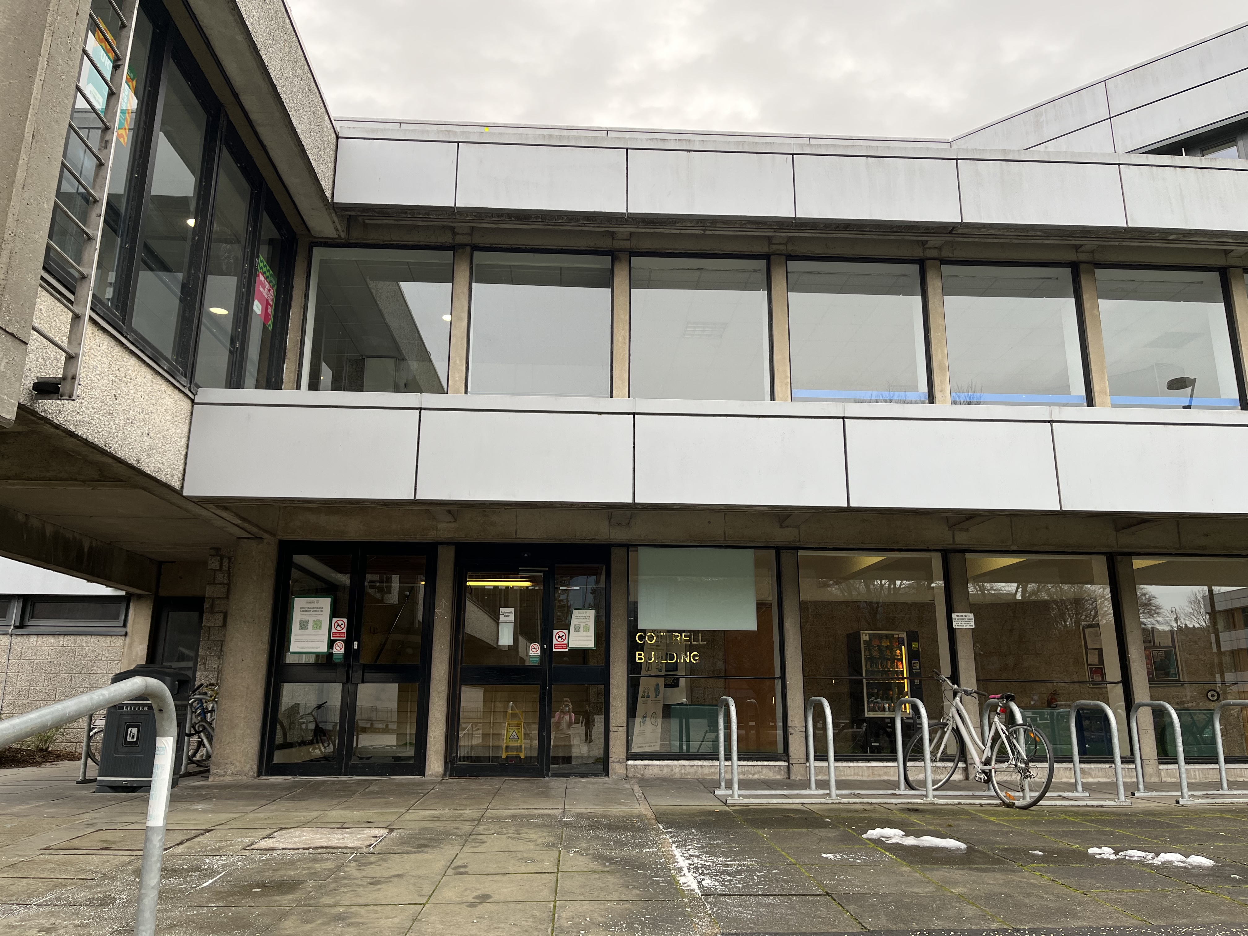
A picture of the entrance to the Cottrell Building, when entering from Queen’s court.

Slide 18
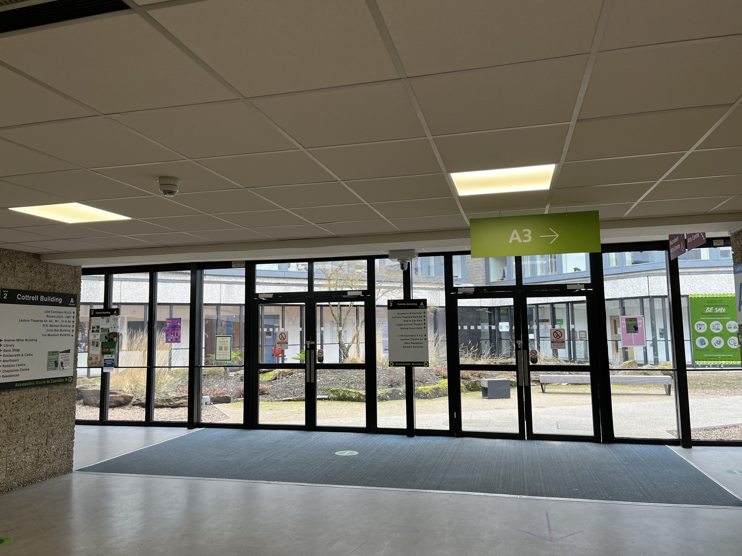
A picture of the entrance hall just after you have entered the building from the Queen’s Court entrance.
The red arrow marks the direction of the STAR lab

Slide 19
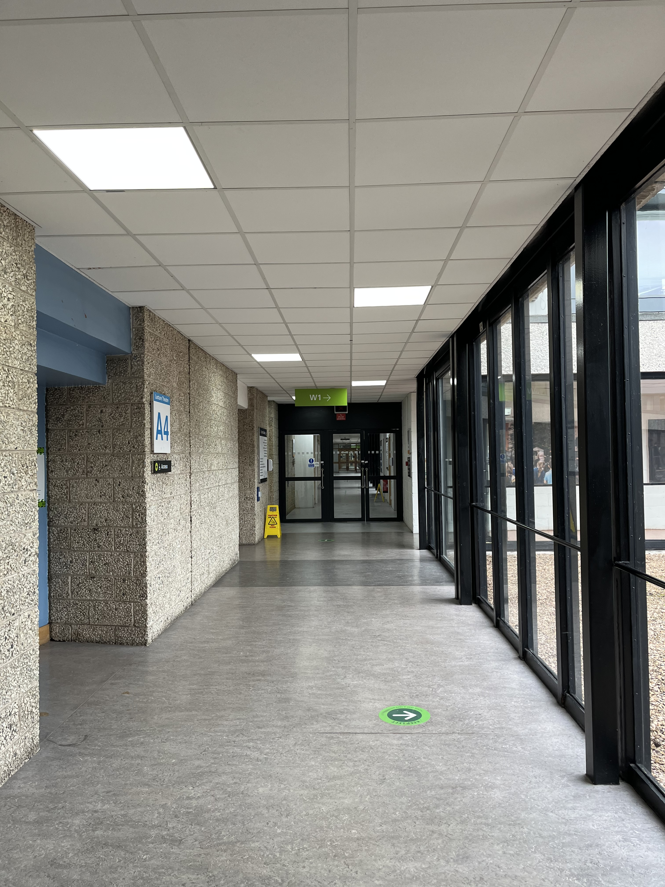
A picture of the corridor leading to the STAR Room. The lab is located just beyond the double doors at the end of the corridor.

